Slide 1
UNIT 3 Cloud Virtualization Technology

Slide 2
Introduction
In recent years, computing becomes more complex and requires large infrastructure.
The organizations invest huge amount on buying additional physical infrastructure as and when there is a need for more computing resources.
If you look at the capital expenditure (CapEx) and operational expenditure (OpEx) of buying and maintaining large infrastructure, it is really high.

Slide 3
Introduction
At the same time, the resource utilization and return on investment (ROI) on buying the additional infrastructure are very low.
To increase the resource utilization and ROI, the companies started using the technology called virtualization where a single physical infrastructure can be used to run multiple operating systems (OSs) and applications

Slide 4
Introduction
Virtualization is a technology that enables the single physical infrastructure to function as a multiple logical infrastructure or resources.
Virtualization is not only limited to the hardware, it can take many forms such as memory, processor, I/O, network, OS, data, and application.

Slide 5
Introduction
Before virtualization, the single physical infrastructure was used to run a single OS and its applications, which results in underutilization of resources.
The non-shared nature of the hardware forces the organizations to buy a new hardware to meet their additional computing needs.
After virtualization was introduced, different OSs and applications were able to share a single physical infrastructure.
The virtualization reduces the huge amount invested in buying additional resources.
The virtualization becomes a key driver in the IT industry, especially in cloud computing.

Slide 6
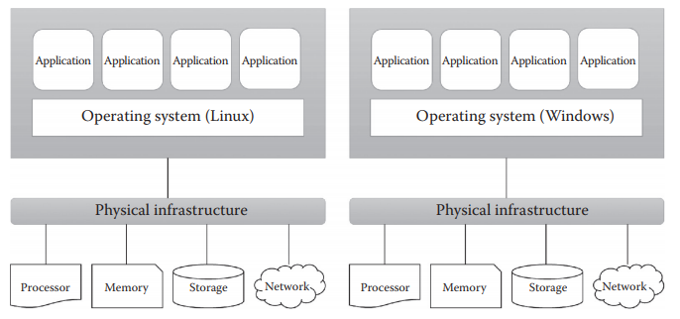
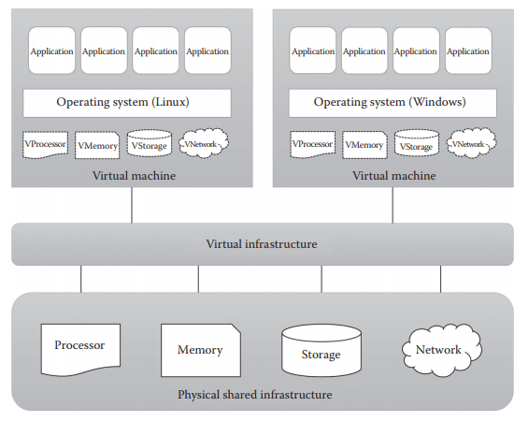
Fig: Before Virtualization
Fig: After Virtualization

Slide 7
Virtualization
Virtualization is a technique, which allows to share single physical instance of an application or resource among multiple organizations or tenants.
Virtualization is a partitioning of single physical server into multiple logical servers.
Once the physical server is divided, each logical server behaves like a physical server and can run an operating system and applications independently.

Slide 8
Virtualization
It does so by assigning a logical name to a physical resource and providing a pointer to that physical resource on demand.
For software developers and testers virtualization comes very handy, as it allows developer to write code that runs in many different environments and more importantly to test that code.
Many popular companies' like VMware and Microsoft provide virtualization services.

Slide 9
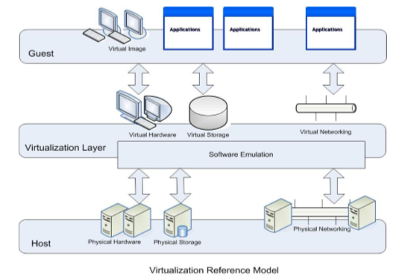

Slide 10
Virtualization Concept
Virtual Machines provide an environment that is logically separated from the underlying hardware.
The machine on which the virtual machine is created is known as host machine and virtual machine is referred as a guest machine.
This virtual machine is managed by a software or firmware, which is known as hypervisor.

Slide 11
Hypervisor
Hypervisor is computer program or software that creates and run virtual machines.
Hypervisors are virtual machine monitor(VMM) that enables numbers of virtual operating systems to simultaneously run on a computer system.
These virtual machines are also referred as guest machines and they all share the hardware of the physical machine like memory, processor, storage and other related resources.

Slide 12
Hypervisor
This improves and enhances the utilization of the underlying resources.
The hypervisor drives the concept of virtualization by allowing the physical host machine to operate multiple virtual machines as guests.
Hypervisor is mainly classified into two:
Type 1/Native/Bare Metal Hypervisor
Type 2/Hosted Hypervisor

Slide 13
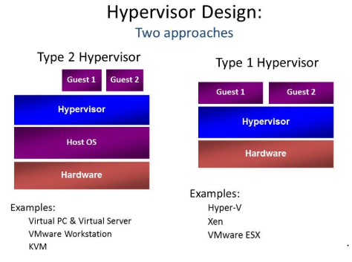
Type 1 & Type 2 Hypervisor: Example

Slide 14
Virtualization Opportunities
Virtualization is the process of abstracting the physical resources to the pool of virtual resources that can be given to any virtual machines (VMs).
The different resources like memory, processors, storage, and network can be virtualized using proper virtualization technologies.

Slide 15
Processor Virtualization
Processor virtualization allows the VMs to share the virtual processors that are abstracted from the physical processors available at the underlying infrastructure.
The virtualization layer abstracts the physical processor to the pool of virtual processors that is shared by the VMs.

Slide 16
Processor Virtualization
The virtualization layer will be normally any hypervisors.
Processor virtualization from a single hardware is illustrated in Figure below. But processor virtualization can also be achieved from distributed servers.

Slide 17
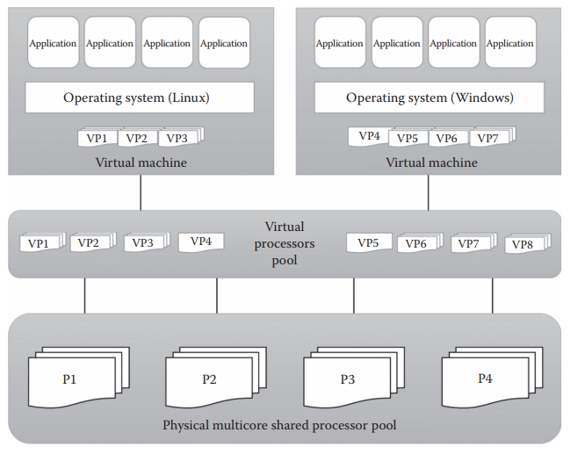

Slide 18
Memory Virtualization
The process of providing a virtual main memory to the VMs is known as memory virtualization or main memory virtualization.
In main memory virtualization, the physical main memory is mapped to the virtual main memory.
The concept of main memory virtualization is illustrated in figure below.

Slide 19
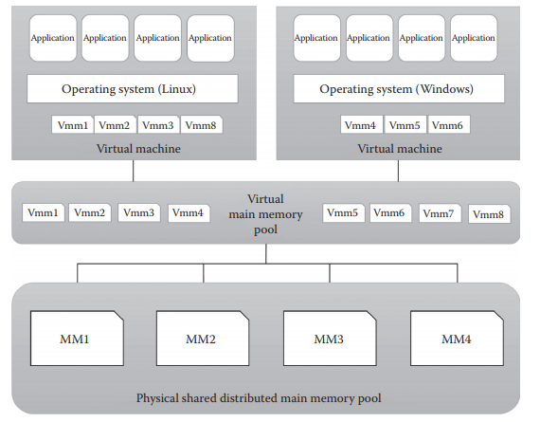

Slide 20
Storage Virtualization
Storage virtualization is a form of resource virtualization where multiple physical storage disks are abstracted as a pool of virtual storage disks to the VMs.
Normally, the virtualized storage will be called a logical storage.

Slide 21
Storage Virtualization
Storage virtualization is mainly used for maintaining a backup or replica of the data that are stored on the VMs.
It can be further extended to support the high availability of the data.
Figure below illustrates the process of storage virtualization.

Slide 22
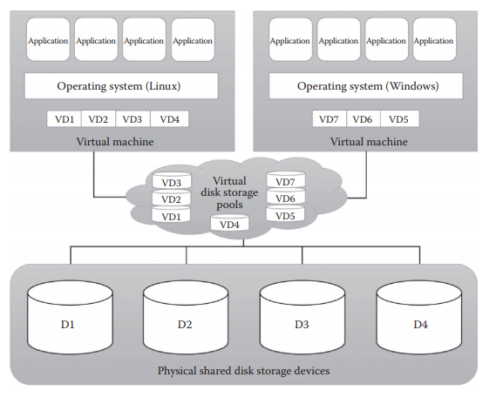

Slide 23
Network Virtualization
Network virtualization is a type of resource virtualization in which the physical network can be abstracted to create a virtual network.
The physical network components like router, switch, and Network Interface Card (NIC) will be controlled by the virtualization software to provide virtual network components.
The virtual network is a single software-based entity that contains the network hardware and software resources.

Slide 24
Network Virtualization
Network virtualization can be achieved from internal network or by combining many external networks.
The other advantage of network virtualization is it enables the communication between the VMs that share the physical network.
The concept of network virtualization is illustrated in Figure below

Slide 25
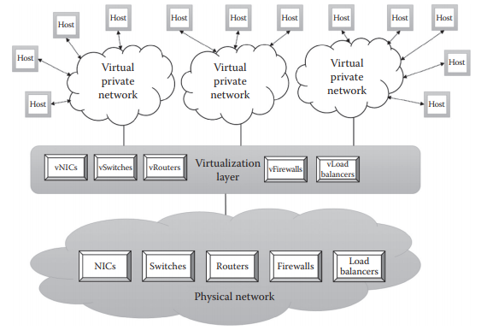

Slide 26
Data Virtualization
Data virtualization is the ability to retrieve the data without knowing its type and the physical location where it is stored.
It aggregates the heterogeneous data from the different sources to a single logical/virtual volume of data.
This logical data can be accessed from any applications such as web services, E-commerce applications, web portals, Software as a Service (SaaS) applications, and mobile application.

Slide 27
Data Virtualization
Data virtualization hides the type of the data and the location of the data for the application that access it.
It also ensures the single point access to data by aggregating data from different sources.
Figure below represents data virtualization technology.

Slide 28
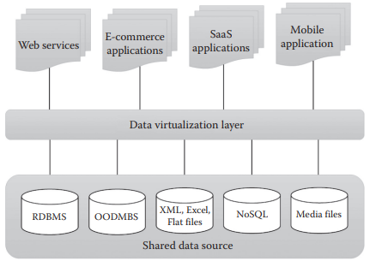

Slide 29
Application Virtualization
Application virtualization is the enabling technology for SaaS of cloud computing.
The application virtualization offers the ability to the user to use the application without the need to install any software or tools in the machine.
Here, the complexity of installing the client tools or other supported software is reduced.

Slide 30
Application Virtualization
Normally, the applications will be developed and hosted in the central server.
The hosted application will be again virtualized, and the users will be given the separated/isolated virtual copy to access.
The concept of application virtualization is illustrated in Figure below.

Slide 31
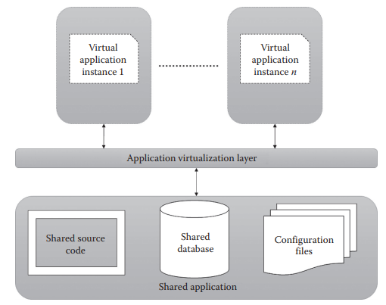

Slide 32
Hardware Virtualization
Creating a virtual machine over existing operating system and hardware and above it we run other operating systems or applications. This is called Hardware Virtualization.
The virtual machine provides a separate environment that is logically distinct from its underlying hardware.

Slide 33
Hardware Virtualization
The term virtualization is often synonymous with hardware virtualization, which plays a fundamental role in efficiently delivering Infrastructure-as-a-Service (IaaS) solutions for cloud computing.
Moreover, virtualization technologies provide a virtual environment for not only executing applications but also for storage, memory, and networking.
Here, the system or the machine is the host & virtual machine is the guest machine.

Slide 34
Approaches to Virtualization
There are three different approaches to virtualization.
Before discussing them, it is important to know about protection rings in OSs.
Protection rings are used to isolate the OS from untrusted user applications.
The OS can be protected with different privilege levels.

Slide 35
Approaches to Virtualization
In protection ring architecture, the rings are arranged in hierarchical order from ring 0 to ring 3 as shown in Figure below.
Ring 0 contains the programs that are most privileged, and ring 3 contains the programs that are least privileged.

Slide 36
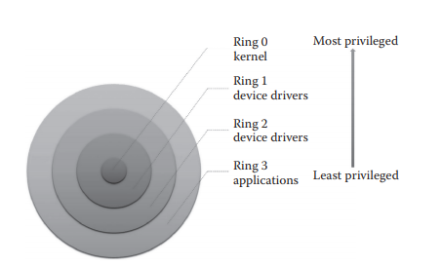

Slide 37
Protection Ring
Normally, the highly trusted OS instructions will run in ring 0, and it has unrestricted access to physical resources.
Ring 3 contains the untrusted user applications, and it has restricted access to physical resources.
The other two rings (ring 1 and ring 2) are allotted for device drivers.

Slide 38
Protection Ring
This protection ring architecture restricts the misuse of resources and malicious behavior of untrusted user-level programs.
For example, any user application from ring 3 cannot directly access any physical resources as it is the least privileged level.

Slide 39
Protection Ring
But the kernel of the OS at ring 0 can directly access the physical resources as it is the most privileged level.
Depending on the type of virtualization, the hypervisor and guest OS will run in different privilege levels.
Normally, the hypervisor will run with the most privileged level at ring 0, and the guest OS will run at the least privileged level than the hypervisor.
There are three types of approaches followed for virtualization:
Full virtualization
Paravirtualization
Hardware-assisted virtualization

Slide 40
Full Virtualization
In full virtualization, the guest OS is completely abstracted from the underlying infrastructure.
The virtualization layer or virtual machine manager (VMM) fully decouples the guest OS from the underlying infrastructure.
The guest OS is not aware that it is virtualized and thinks it is running on the real hardware.
In this approach, the hypervisor or VMM resides at ring 0 and provides all the virtual infrastructures needed for VMs.

Slide 41
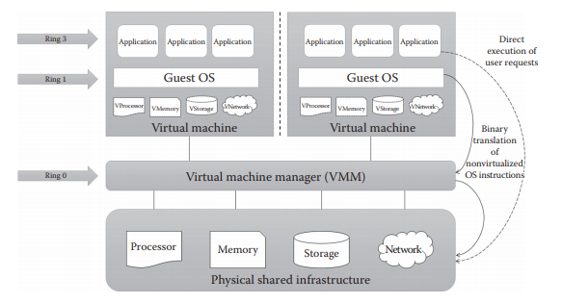
Full Virtualization

Slide 42
Full Virtualization
The guest OS resides at ring 1 and has the least privilege than the hypervisor.
Hence, the OS cannot communicate to the physical infrastructure directly.
It requires the help of hypervisors to communicate with the underlying infrastructure.
The user applications reside at ring 3, as shown in Figure above.

Slide 43
Full Virtualization
Pros
This approach provides the best isolation and security for the VMs.
Different OSs can run simultaneously.
The virtual guest OS can be easily migrated to work in native hardware.
It is easy to install and use and does not require any change in the guest OS.
Cons
Binary translation is an additional, overhead, and it reduces the overall system performance.
There is a need for correct combination of hardware and software.

Slide 44
Paravirtualization
This approach is also known as partial virtualization or OS-assisted virtualization and provides partial simulation of the underlying infrastructure.
The main difference between the full virtualization and paravirtualization is the guest OS knows that it is running in virtualized environment in paravirtualization.
But in full virtualization, this information is not known to the guest OS.
Another difference is that the paravirtualization replaces the translation of nonvirtualized OS requests with hypercalls.

Slide 45
Paravirtualization
Hypercalls are similar to system calls and used for the direct communication between OS and hypervisor.
This direct communication between the guest OS and hypervisor improves performance and efficiency.
In full virtualization, the guest OS will be used without any modification.
But in paravirtualization, the guest OS needs to be modified to replace nonvirtualizable instructions with the hypercalls.

Slide 46
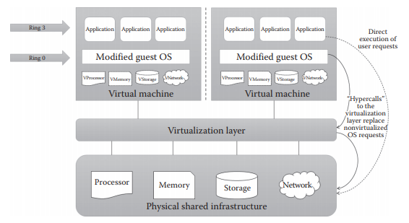

Slide 47
Paravirtualization
Pros
It eliminates the additional overhead of binary translation and hence improves the overall system efficiency and performance.
It is easier to implement than full virtualization as there is no need for special hardware.
Cons
There is an overhead of guest OS kernel modification.
The modified guest OS cannot be migrated to run on physical hardware.
VMs suffer from lack of backward compatibility and are difficult to migrate to other hosts.

Slide 48
Hardware-Assisted Virtualization
In the two previous approaches, there is an additional overhead of binary translation or modification of guest OS to achieve virtualization.
But in this approach, hardware vendors itself, like Intel and AMD, offer the support for virtualization, which eliminates much overhead involved in the binary translation and guest OS modification.
Popular hardware vendors like Intel and AMD has given the hardware extension to their x86-based processor to support virtualization.

Slide 49
Hardware-Assisted Virtualization
For example, the Intel releases its Intel Virtualization Technology (VT-x) and AMD releases its AMD-v to simplify the virtualization techniques.
In hardware-assisted virtualization, the VMM has the highest privilege (root privilege) level even though it is working below ring 0.
The OS resides at ring 0 and the user application at ring 3, as shown in Figure below.

Slide 50
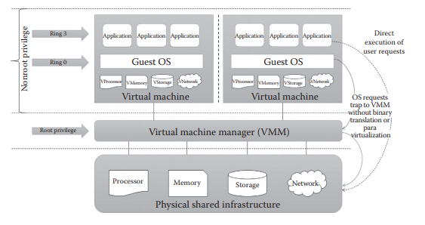

Slide 51
Hardware-Assisted Virtualization
Pros
It reduces the additional overhead of binary translation in full virtualization.
It eliminates the guest OS modification in paravirtualization.
Cons
Only new-generation processors have these capabilities.

Slide 52
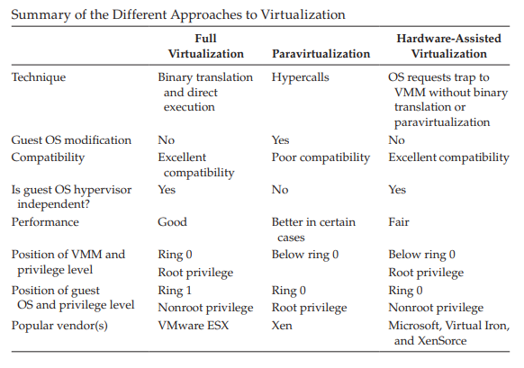

Slide 53
Features of virtualization
Partitioning: Multiple virtual servers can run on a physical server at the same time.
Encapsulation of data: All data on the virtual server including boot disks is encapsulated in a file format
Isolation: The Virtual server running on the physical server are safely separated & don't affect each other
Hardware Independence: When the virtual server runs, it can migrate to the different hardware platform.

Slide 54
The Advantages of Virtualization
It is cheaper. Because virtualization doesn’t require actual hardware components to be used or installed, IT infrastructures find it to be a cheaper system to implement. There is no longer a need to dedicate large areas of space and huge monetary investments to create an on-site resource.
It keeps costs predictable. Because third-party providers typically provide virtualization options, individuals and corporations can have predictable costs for their information technology needs.

Slide 55
The Advantages of Virtualization
3. It reduces the workload. Most virtualization providers automatically update their hardware and software that will be utilized. Instead of sending people to do these updates locally, they are installed by the third-party provider. This allows local IT professionals to focus on other tasks and saves even more money for individuals or corporations.
4. It allows for faster deployment of resources. Resource provisioning is fast and simple when virtualization is being used. There is no longer a need to set up physical machines, create local networks, or install other information technology components. As long as there is at least one point of access to the virtual environment, it can be spread to the rest of the organization.

Slide 56
The Advantages of Virtualization
5. It offers a better uptime.
6. Increased IT productivity, efficiency
7. Greater business continuity and disaster recovery.
8. Easier backup and disaster recovery

Slide 57
The Disadvantages of Virtualization
It can have a high cost of implementation.
It creates a security risk.
It creates an availability issue.

Slide 58
Thank you

